Slide 1



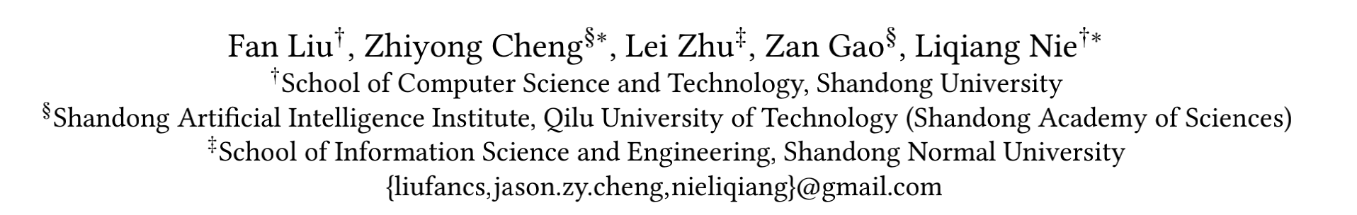

Chongqing University of Technology
ATAI
Advanced Technique of Artificial Intelligence
Chongqing University of Technology
Interest-aware Message-Passing GCN for Recommendation
https://github.com/liufancs/IMP_GCN
（WWW-2021)
Reported by Jia Wang
Notes:
基于兴趣感知消息传递GCN的推荐

Slide 2

Chongqing University of Technology
ATAI
Advanced Technique of Artificial Intelligence
Chongqing University of Technology
1. Introduction
2. Approach
3. Experiments
4. Conclusion

Slide 3
Introduction
We step into the over-smoothing problem in existing GCN-based recommendation models and point out an overlooked factor:
• exploiting high-order neighbors indiscriminately makes the embeddings of users with dissimilar interests to be similar.
• We propose an IMP-GCN model which exploits high-order neighbors from the same subgraph, in which the user nodes share more similar interests than those in other subgraphs. It is proved to be effective on alleviating the over-smoothing problem.
• We design a subgraph generation module to group users and generate subgraphs from the user-item bipartite graph by considering users features and graph structure information.
• We conduct empirical studies on three benchmark datasets to evaluate the proposed IPM-GCN model. Results show that IPM_GCN can gain improvement by stacking more layers and learn better user/item embeddings, and thus outperforms the SOTA GCN-based recommendation models with a large margin.

Slide 4


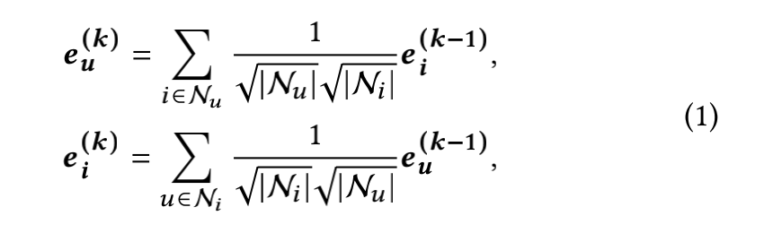
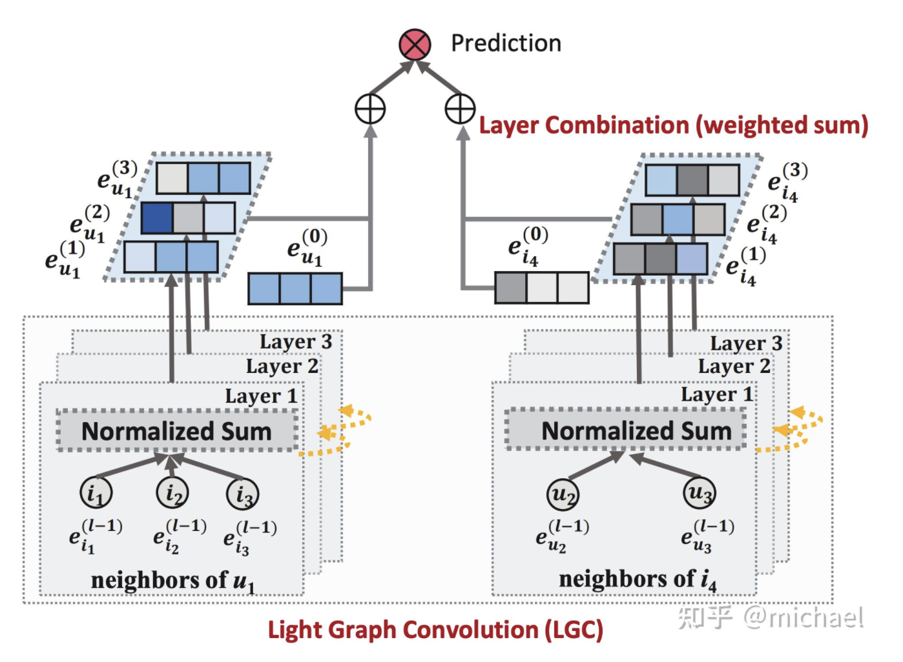
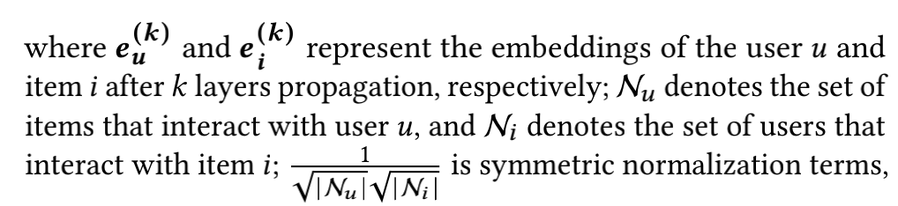
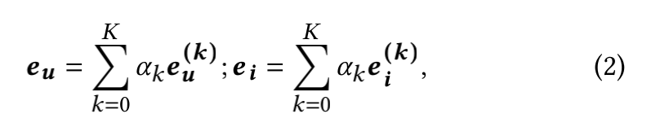
Approach

Slide 5
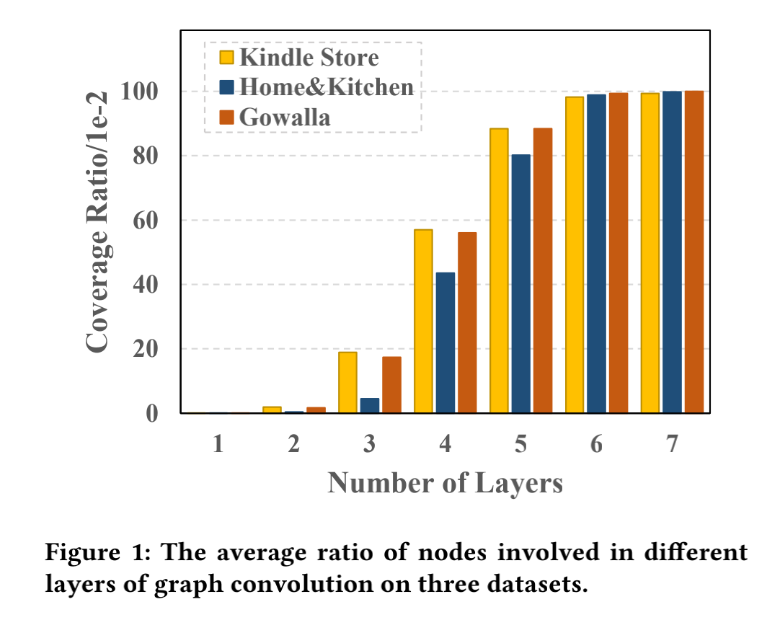
Approach

Slide 6
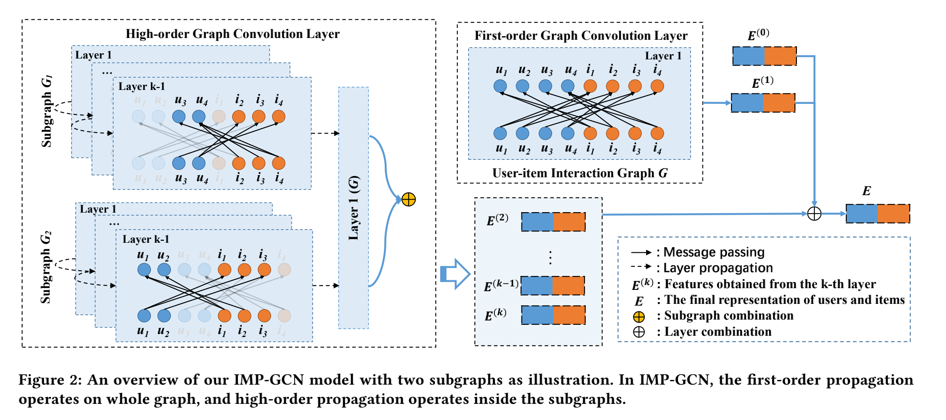
Approach

Slide 7
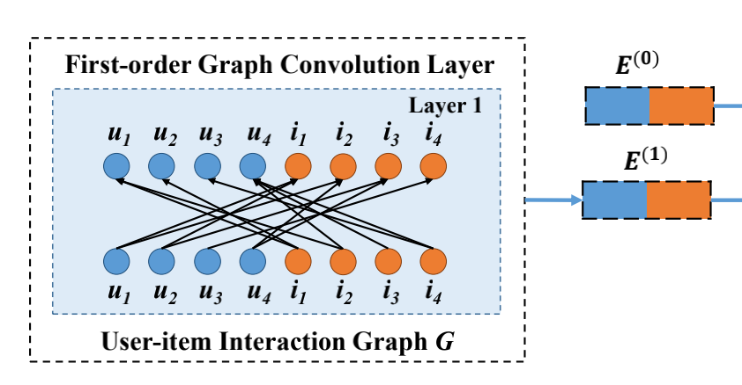
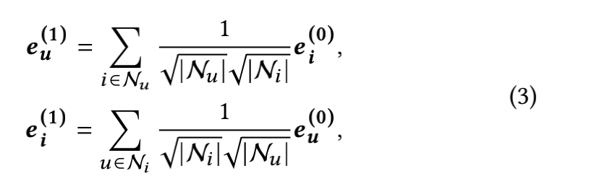
Approach

Slide 8

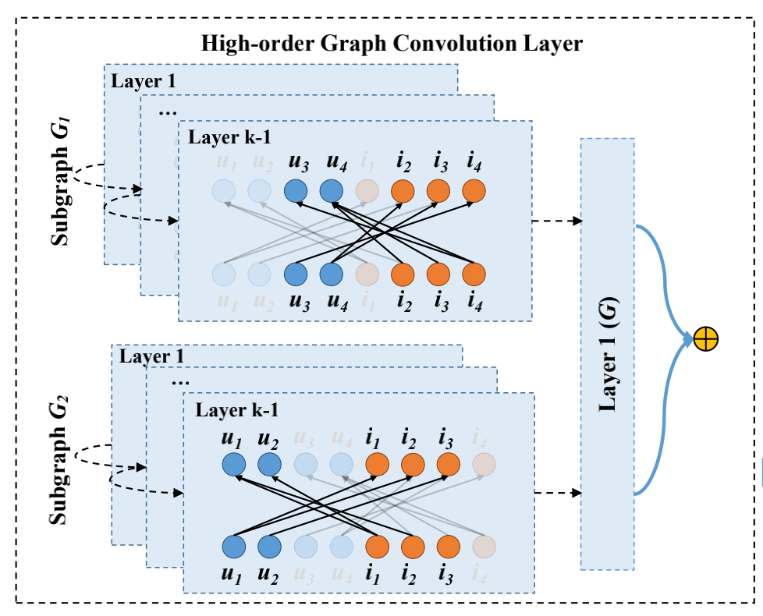
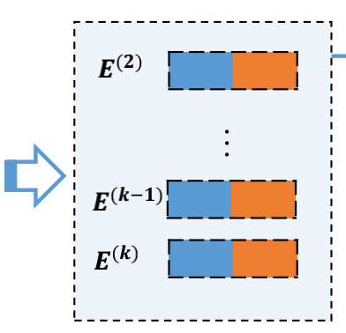
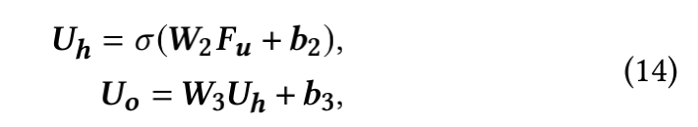
Approach

Slide 9
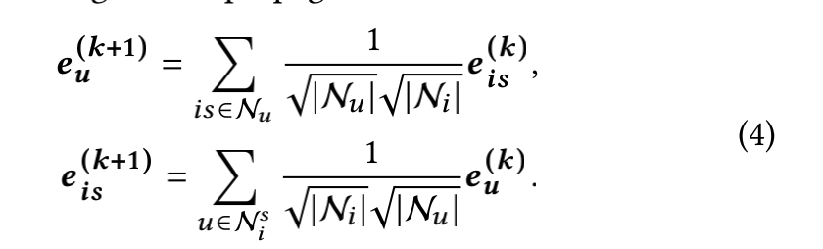
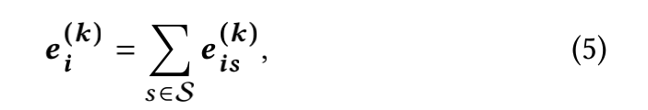

Approach

Slide 10



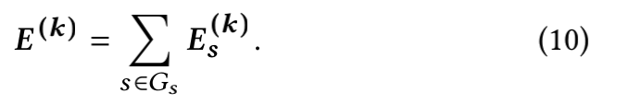
Approach

Slide 11

Approach

Slide 12
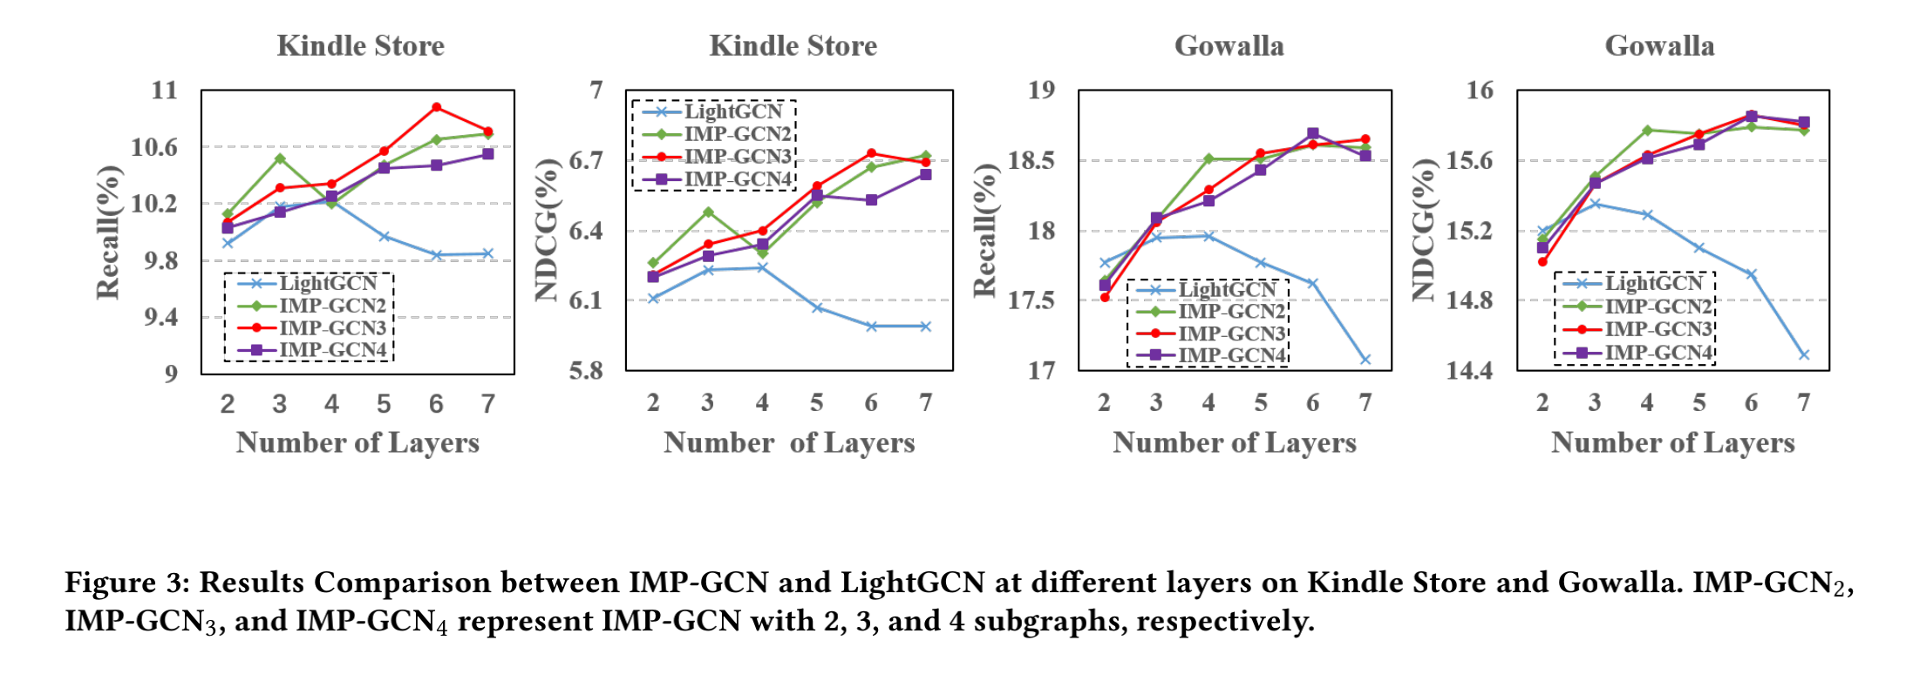
Experiments

Slide 13
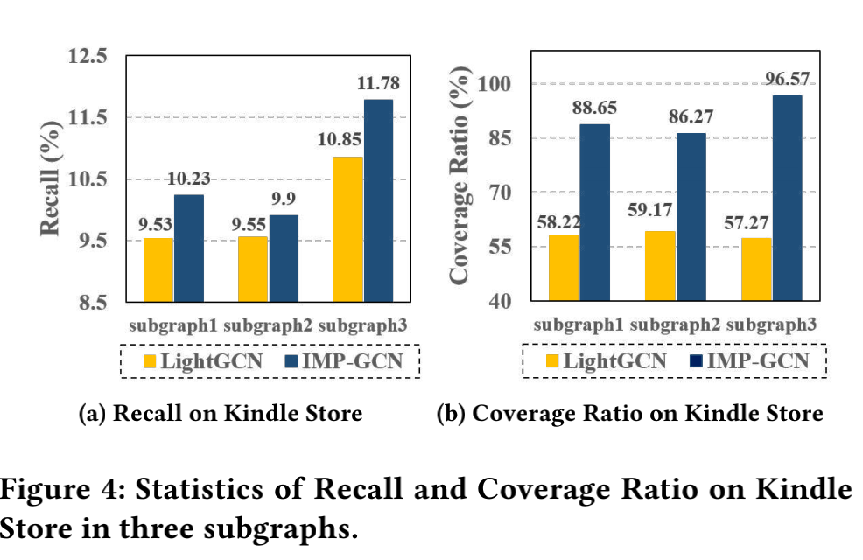
Experiments

Slide 14
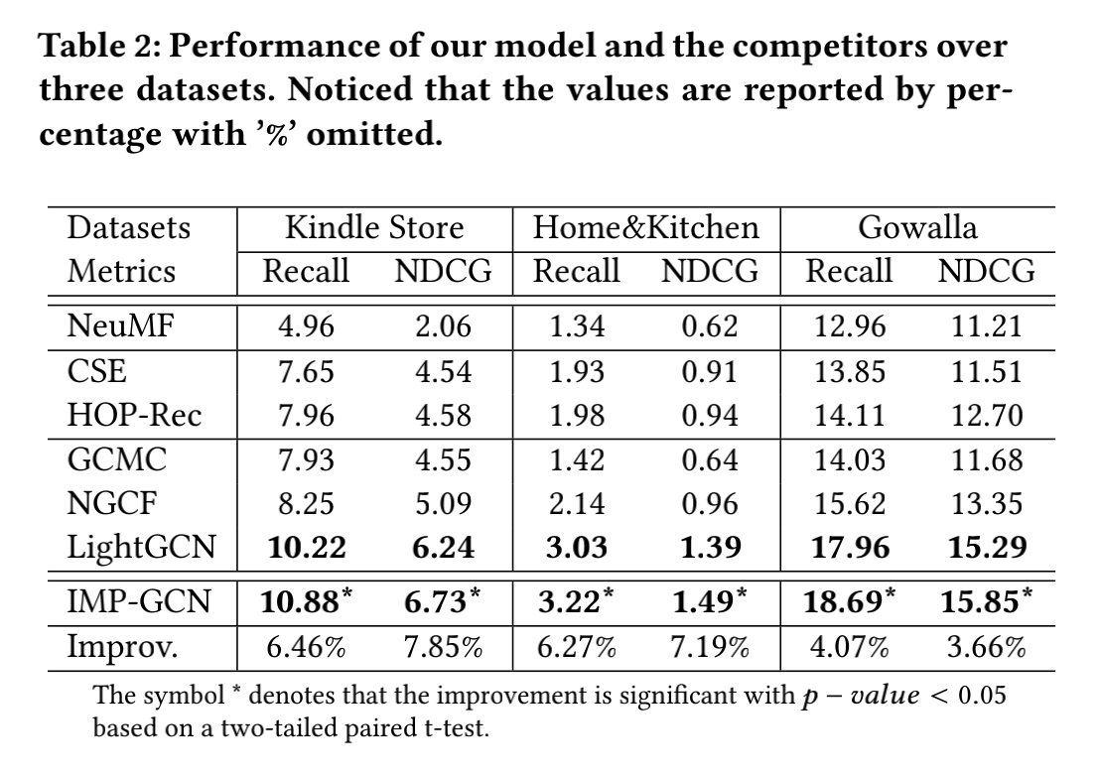
Experiments

Slide 15
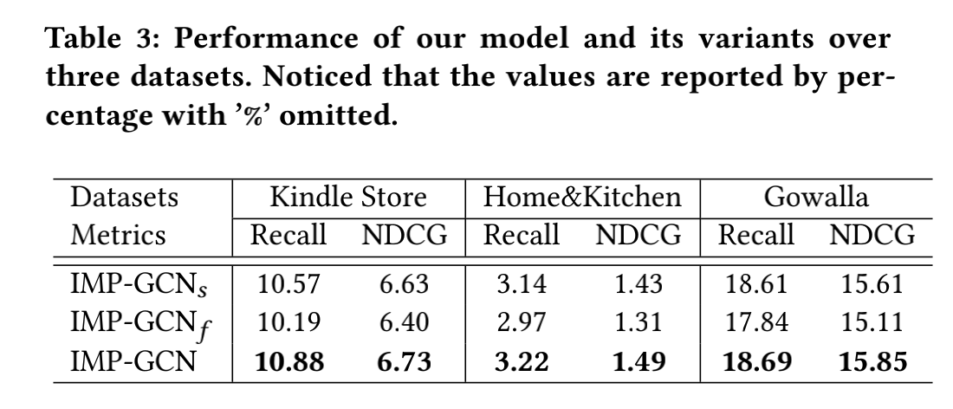
Experiments

Slide 16
Conclusion
In this work, we argued that exploiting high-order node indiscriminately would introduce negative information into the embedding propagation in the GCN-based recommendation models, causing the performance degradation when stacking more layers. We presented a IMP-GCN model which learns user and item embeddings by performing high-order graph convolution inside subgraphs. The subgraphs are formed by a designed subgraph generation algorithm that groups users with similar interests and their interacted items into the same graph. In IMP-GCN, the embedding of a node learned in a subgraph only contributes to the embedding learning of other nodes in this subgraph. In this way, IMP-GCN can effectively avoid taking the noisy information into the embedding learning. Experiments on large-scale real-world datasets demonstrate that IMP-GCN can gain improvements by stacking more layers to exploit information from higher-order neighbors, and achieve the state-of-the-art performance. The advantages of IMP-GCN indicate the importance of distinguishing high-order neighbors on tackling the over-smoothing problem in GCN models. We believe the insights in this study can shed light on the further development of graph-based recommendation models.

Slide 17
Thanks

